Slide 1
Week 4
September 22-26
Five Mini-Lectures
QMM 510
Fall 2014

Slide 2

Probability ML 4.1
Chapter 5
Chapter Contents
5.1 Random Experiments
5.2 Probability
5.3 Rules of Probability
5.4 Independent Events
5.5 Contingency Tables
5.6 Tree Diagrams
5.7 Bayes’ Theorem
5.8 Counting Rules
So many topics … but hopefully much of this is review?
Notes:
Contents of the Chapter:
There are eight sections in this chapter. The topics in each section are listed above.

Slide 3

Random Experiments
Chapter 5
Sample Space
A random experiment is an observational process whose results cannot be known in advance.
The set of all outcomes (S) is the sample space for the experiment.
A sample space with a countable number of outcomes is discrete.
Notes:
Random Experiments:
In this chapter we will deal with random experiments. A random experiment is one in which we do not know the outcome in advance.
The set of all possible outcomes for the experiment is called a sample space.

Slide 4

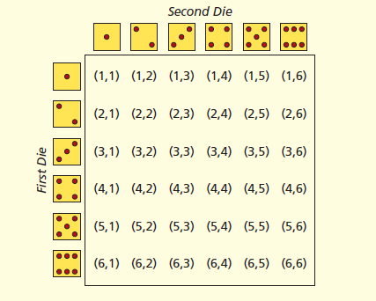
Random Experiments
Chapter 5
Sample Space
For a single roll of a die, the sample space is:
When two dice are rolled, the sample space is pairs:
5A-4
Notes:
Random Experiments:
The slide shows an example of rolling a six-sided die once and twice. The graphics display the sample spaces for these experiments.

Slide 5
Probability
Chapter 5
Definitions
The probability of an event is a number that measures the relative likelihood that the event will occur.
The probability of event A [denoted P(A)] must lie within the interval from 0 to 1:
0 ≤ P(A) ≤ 1
If P(A) = 0, then the event cannot occur.
If P(A) = 1, then the event
is certain to occur.
Notes:
Probability:
The probability of an event quantifies the relative likelihood of that event occurring.
The probability of any event lies between 0 and 1 inclusive.
If the probability of the event is zero, then the event will never occur.
If the probability of the event is one, then the event is sure to occur.

Slide 6
Probability
Chapter 5
Empirical Approach
Use the empirical or relative frequency approach to assign probabilities by counting the frequency (f_{i}) of observed outcomes defined on the experimental sample space.
For example, to estimate the default rate on student loans:
number of defaults
number of loans
P(a student defaults) = f /n
=
Notes:
Probability:
When we use the empirical approach to measure probability for a given event, we are measuring the proportion of times that particular event occurred from a given number of trials.

Slide 7
Probability
Chapter 5
Law of Large Numbers
The law of large numbers says that as the number of trials increases, any empirical probability approaches its theoretical limit.
Flip a coin 50 times. We would expect the proportion of heads to be near .50.
However, in a small finite sample, any ratio can be obtained (e.g., 1/3, 7/13, 10/22, 28/50, etc.).
A large n may be needed to get close to .50.
Notes:
Probability:
The law of large numbers says that as the number of trials increases in an experiment, then the relative frequency probability of an event will approach the theoretical probability of the event.

Slide 8
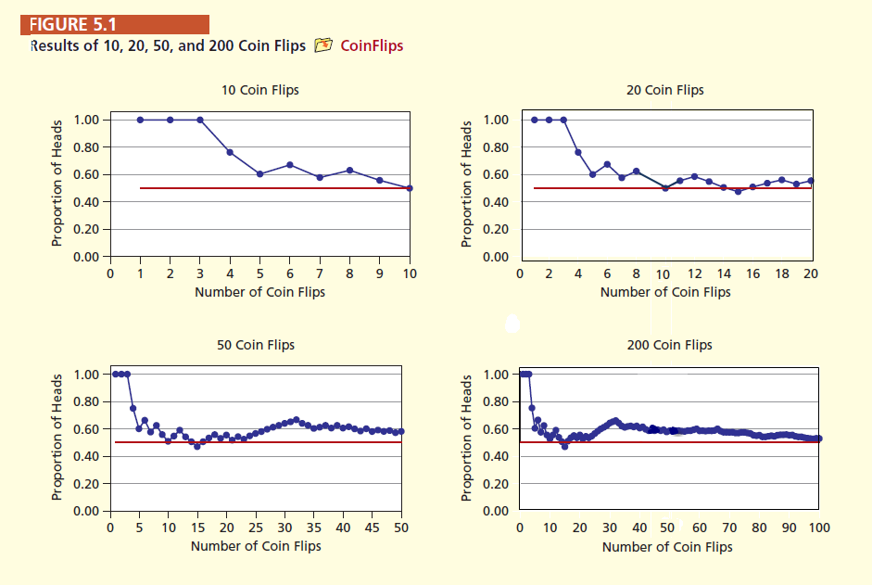
Probability
Chapter 5
Law of Large Numbers
As the number of trials increases, any empirical probability approaches its theoretical limit.
Notes:
Probability:
The slide shows four simulations to demonstrate the law of large numbers.

Slide 9
Probability
Chapter 5
Classical Approach
A priori refers to the process of assigning probabilities before the event is observed or the experiment is conducted.
A priori probabilities are based on logic, not experience.
When flipping a coin or rolling a pair of dice, we do not actually have to perform an experiment because the nature of the process allows us to envision the entire sample space.
Notes:
Probability:
The classical approach to probability assumes that each simple event in the sample space has an equal chance of occurring.

Slide 10

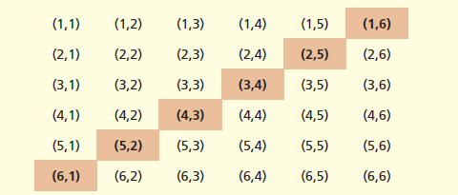
Probability
Chapter 5
Classical Approach
For example, the two-dice experiment has 36 equally likely simple events. The P(that the sum of the dots on the two faces equals 7) is
The probability is obtained a priori using the classical approach as shown in this Venn diagram for 2 dice:
Notes:
Probability:
This slide gives an example to demonstrate the concept of the classical approach to probability.

Slide 11

Probability
Chapter 5
Subjective Approach
A subjective probability reflects someone’s informed judgment about the likelihood of an event.
Used when there is no repeatable random experiment.
For example:
What is the probability that a new truck
product program will show a return on
investment of at least 10 percent?
What is the probability that the price of Ford’s
stock will rise within the next 30 days?
Notes:
Probability:
Another approach to probability is the subjective approach. One can assign a probability of an event that is based on that person’s life experiences. This approach is not uniform since two reasonable people can assign different probabilities to the same event occurring.

Slide 12
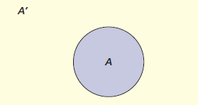

Rules of Probability
Chapter 5
Complement of an Event
The complement of an event A is denoted by
A′ and consists of everything in the sample space S except event A.
Since A and A′ together comprise the entire sample space,
P(A) + P(A′ ) = 1 or P(A′ ) = 1 – P(A)
Notes:
Rules of Probability:
Sometimes it is better to deal with what is outside an event rather than dealing with the event itself. By dealing with what is outside the event, we may be able to reduce the problem to a simpler one.
The set outside the event is called the complement of the event.

Slide 13
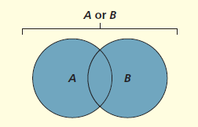

Rules of Probability
Chapter 5
Union of Two Events
(Figure 5.5)
The union of two events consists of all outcomes in the sample space S that are contained either in event A or in event B or in both (denoted A ∪ B or “A or B”).
∪ may be read as “or” since one or the other or both events may occur.
Notes:
Rules of Probability:
The union of two events is an example of a compound event.
The union of two events involves all the elements within the two events without replicating any elements.
Figure 5.4 shows a Venn diagram demonstrating the union of two events.

Slide 14
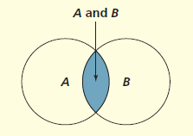

Rules of Probability
Chapter 5
Intersection of Two Events
The intersection of two events A and B
(denoted by A ∩ B or “A and B”) is the event consisting of all outcomes in the sample space S that are contained in both event A and event B.
∩ may be read as “and” since both events occur. This is a joint probability.
Notes:
Rules of Probability:
Sometimes we are only interested in what is common to the two events. This common set is called the intersection of the two events.
Figure 5.5 shows a Venn diagram demonstrating the intersection of two events.

Slide 15
Rules of Probability
Chapter 5
General Law of Addition
The general law of addition states that the probability of the union of two events A and B is:
P(A ∪ B) = P(A) + P(B) – P(A ∩ B)
When you add P(A) and P(B) together, you count P(A and B) twice.
A and B
So, you have to subtract
P(A ∩ B) to avoid overstating the probability.
A
B
Notes:
Rules of Probability:
The general law of probability gives the relationship from which we can compute the probability of the union of two events.

Slide 16
Rules of Probability
Chapter 5
General Law of Addition
For a standard deck of cards:
P(Q) = 4/52 (4 queens in a deck; Q = queen)
P(R) = 26/52 (26 red cards in a deck; R = red)
P(Q ∩ R) = 2/52 (2 red queens in a deck)
P(Q ∪ R) = P(Q) + P(R) – P(Q ∩ R)
Q and R = 2/52
= 4/52 + 26/52 – 2/52
Q
4/52
R
26/52
= 28/52 = .5385 or 53.85%
Notes:
Rules of Probability:
This slide gives an example of the probability for the union of two events.

Slide 17

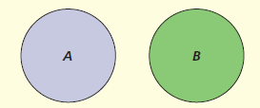
Rules of Probability
Chapter 5
Mutually Exclusive Events
Events A and B are mutually exclusive (or disjoint) if their intersection is the null set (φ) which contains no elements.
If A ∩ B = φ, then P(A ∩ B) = 0
Special Law of Addition
In the case of mutually exclusive events, the addition law reduces to:
P(A ∪ B) = P(A) + P(B)
Notes:
Rules of Probability:
Sometimes there is nothing in common to two events. In this case we say that the two events are mutually exclusive.
Figure 5.6 shows two mutually exclusive events.
Since there is no commonality in two mutually exclusive events, then the probability of the intersection will be zero. Thus the probability of two mutually exclusive events is the sum of the individual probabilities of the two events.

Slide 18
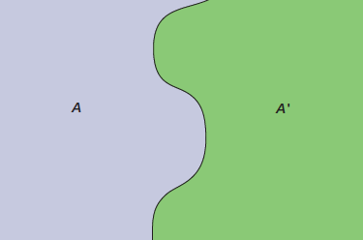
Rules of Probability
Chapter 5
Dicjhotomous Events
Events are collectively exhaustive if their union is the entire sample space S.
Two mutually exclusive, collectively exhaustive events are dichotomous (or binary) events.
For example, a car repair is either covered by the warranty (A) or not (A’).
Note: This concept can be extended to more than two events. See the next slide
Warranty
No
Warranty
Notes:
Rules of Probability:
If the union of a set of events results in the sample space, then we say that these events are collectively exhaustive.
The diagram shows two collectively exhaustive events.

Slide 19
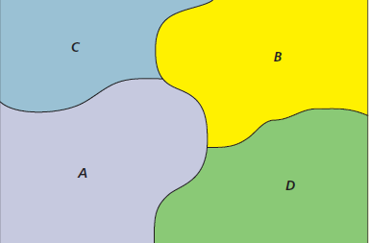
Rules of Probability
Chapter 5
Polytomous Events
There can be more than two mutually exclusive, collectively exhaustive events, as illustrated below. For example, a Walmart customer can pay by credit card (A), debit card (B), cash (C), or
check (D).
Notes:
Rules of Probability:
If the union of a set of events results in the sample space, then we say that these events are collectively exhaustive.
The diagram shows four collectively exhaustive events.

Slide 20

Rules of Probability
Chapter 5
Conditional Probability
The probability of event A given that event B has occurred.
Denoted P(A | B).
The vertical line “ | ” is read as “given.”
Notes:
Rules of Probability:
Sometimes we need to compute the probability of an event given that another event has occurred. Such probabilities are called conditional probabilities.
The slide shows the formula used to compute the conditional probability of the event A given (denoted by the vertical line |) that the event B has occurred.

Slide 21

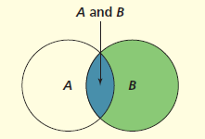
Rules of Probability
Chapter 5
Conditional Probability
Consider the logic of this formula by looking at the Venn diagram.
The sample space is restricted to B, an event that has occurred.
A ∩ B is the part of B that is also in A.
The ratio of the relative size of A ∩ B to B is P(A | B).
Notes:
Rules of Probability:
The sample space is reduced when finding a conditional probability. The sample space is reduced to the space of the event on which the probability is conditioned.
The figure shows that the sample space is reduced to the event B since we were conditioning on the event B.

Slide 22
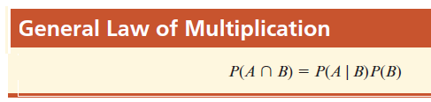
Rules of Probability
Chapter 5
Example: High School Dropouts
Of the population aged 16–21 and not in college:
Unemployed | 13.5%
High school dropouts | 29.05%
Unemployed high school dropouts | 5.32%
What is the conditional probability that a member of this population is unemployed, given that the person is a high school dropout?
Notes:
Rules of Probability:
Rewriting the equation for the conditional probability without the ratio gives the general law of multiplication.
This slide gives the information needed to compute the probabilities on the next slide.

Slide 23

Rules of Probability
Chapter 5
Example: High School Dropouts
Given:
U = the event that the person is unemployed
D = the event that the person is a high school dropout
P(U) = .1350
P(D) = .2905
P(U∩D) = .0532
P(U | D) = .1831 > P(U) = .1350
Therefore, being a high school dropout is related to being unemployed.
Notes:
Rules of Probability:
This slide gives an example for the conditional probability.

Slide 24
Independent Events
Chapter 5
Event A is independent of event B if the conditional probability P(A | B) is the same as the marginal probability P(A).
P(U | D) = .1831 > P(U) = .1350, so U and D are not independent. That is, they are dependent.
Another way to check for independence: Multiplication Law
If P(A ∩ B) = P(A)P(B) then event A is independent of event B since
Notes:
Independent Events:
Two events A and B are independent if the probability of their intersection is the same as the product of the individual probabilities.

Slide 25
Independent Events
Chapter 5
Multiplication Law (for Independent Events)
The probability of n independent events occurring simultaneously is:
P(A₁ ∩ A₂ ∩ ... ∩ A_{n}) = P(A₁) P(A₂) ... P(A_{n})
if the events are independent
To illustrate system reliability, suppose a website has 2 independent file servers. Each server has 99% reliability. What is the total system reliability? Let
F₁ be the event that server 1 fails
F₂ be the event that server 2 fails
Notes:
Independent Events:
The concept of independence can be extended to several events.

Slide 26
Independent Events
Chapter 5
Multiplication Law (for Independent Events)
Applying the rule of independence:
P(F₁ ∩ F₂ ) = P(F₁) P(F₂) = (.01)(.01) = .0001
So, the probability that both servers are down is .0001.
The probability that one or both servers is “up” is:
1 - .0001 = .9999 or 99.99%
Notes:
Independent Events:
This slide presents an example applying the concept of independence.

Slide 27
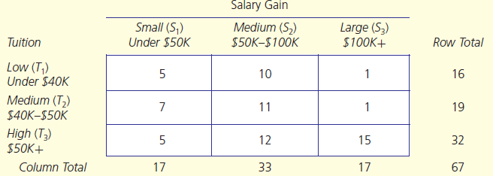
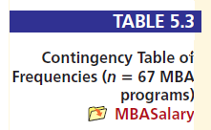
Contingency Table
Chapter 5
Example: Salary Gains and MBA Tuition
Consider the following cross-tabulation (contingency) table for n = 67 top-tier MBA programs:
Notes:
Contingency Table:
A contingency table for two variables is a cross tabulation for the two variables. There may be several categories for the variables in the table. Table 5.3 shows three horizontal and 3 vertical categories for the two variables of tuition and salary gain.
27

Slide 28
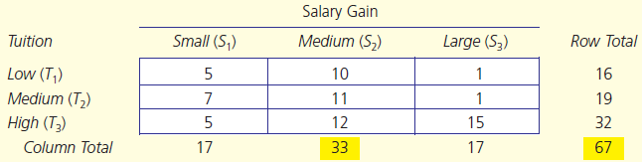
Contingency Table
Chapter 5
The marginal probability of a single event is found by dividing a row or column total by the total sample size.
Example: find the marginal probability of a medium salary gain (P(S₂).
P(S₂) = 33/67 = .4925
About 49% of salary gains at the top-tier schools were between $50,000 and $100,000 (medium gain).
Notes:
Contingency Table:
The table above shows the marginal totals. These can be used to compute the marginal probabilities. An example of the computation is shown on the slide.
28

Slide 29
Contingency Table
Chapter 5
Joint Probabilities
A joint probability represents the intersection of two events in a cross-tabulation table.
Consider the joint event that the school has
low tuition and large salary gains (denoted as P(T₁ ∩ S₃)).
P(T₁ ∩ S₃) = 1/67 = .0149
There is less than a 2% chance that a top-tier school has both low tuition and large salary gains.
Notes:
Contingency Table:
We can also compute joint probabilities. A joint probability is the probability of the intersection of two events in the table.
The slide presents an example of a joint probability.
29

Slide 30
Contingency Table
Chapter 5
Conditional Probabilities
Find the probability that the salary gains are small (S₁) given that the MBA tuition is large (T₃).
P(T₃ | S₁) = 5/32 = .1563
Independence
Conditional | Marginal
P(S₃ | T₁)= 1/16 = .0625 | P(S₃) = 17/67 = .2537
(S₃) and (T₁) are dependent.
Notes:
Contingency Table:
Also, we can compute conditional probabilities.
The slide presents an example of a conditional probability.
Also, one can check whether the row variable is independent of the column variable. An example is presented in the slide.
30

Slide 31
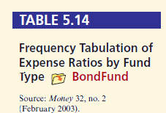
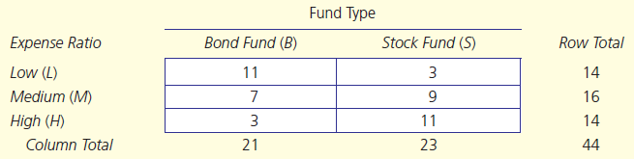
Tree Diagrams
Chapter 5
What is a Tree?
A tree diagram or decision tree helps you visualize all possible outcomes.
Start with a contingency table. For example, this table gives expense ratios by fund type for 21 bond funds and 23 stock funds.
The tree diagram shows all events along with their marginal, conditional, and joint probabilities.
Notes:
Tree Diagrams:
A tree diagram or decision tree helps you visualize all possible outcomes in an experiment.
A tree diagram can be used to display all the events with their marginal, conditional, and joint probabilities for a contingency table.

Slide 32
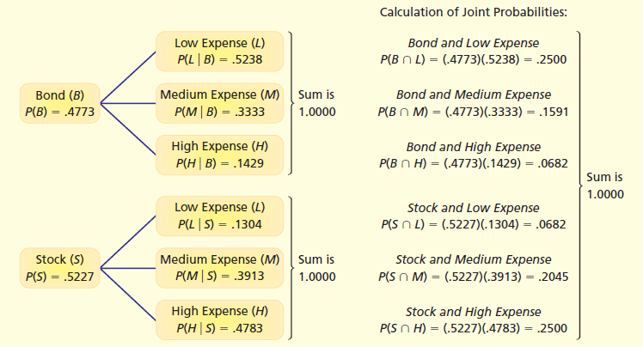

Tree Diagrams
Chapter 5
Tree Diagram for Fund Type and Expense Ratios
Notes:
Tree Diagrams:
Figure 5.8 shows the tree diagram for the contingency table on the previous slide.

Slide 33
Counting Rules
Chapter 5
Fundamental Rule of Counting
If event A can occur in n₁ ways and event B can occur in n₂ ways, then events A and B can occur in n₁ x n₂ ways.
In general, m events can occur
n₁ x n₂ x … x n_{m} ways.
Example: Stockkeeping Labels
How many unique stockkeeping unit (SKU) labels can a hardware store create by using two letters (ranging from AA to ZZ) followed by four numbers (0 through 9)?
Notes:
Counting Rules:
Here we will consider some rules of counting.
The first such rule is the fundamental rule of counting, which allows us to compute the number of ways a sequence of events can occur.
An example is given to apply the fundamental rule of counting.
33

Slide 34
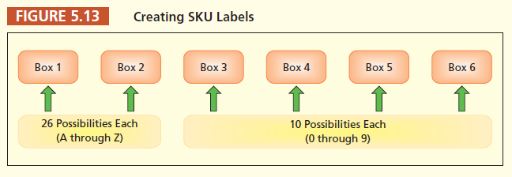
Counting Rules
Chapter 5
Example: Stockkeeping Labels
For example, AF1078: hex-head 6 cm bolts – box of 12;
RT4855: Lime-A-Way cleaner – 16 ounce LL3319: Rust-Oleum primer – gray 15 ounce
There are 26 x 26 x 10 x 10 x 10 x 10 = 6,760,000 unique inventory labels.
Notes:
Counting Rules:
Here we will consider some rules of counting.
The first such rule is the fundamental rule of counting, which allows us to compute the number of ways a sequence of events can occur.
The example applying the fundamental rule of counting is continued on this slide .
34

Slide 35
Counting Rules
Chapter 5
Factorials
The number of ways that n items can be arranged in a particular order is n factorial.
n factorial is the product of all integers from 1 to n.
n! = n(n–1)(n–2)...1
Factorials are useful for counting the possible arrangements of any n items.
There are n ways to choose the first, n-1 ways to choose the second, and so on.
A home appliance service truck must make 3 stops (A, B, C). In how many ways could the three stops be arranged?
Answer: 3! = 3 x 2 x 1 = 6 ways
Notes:
Counting Rules:
Another counting rule deals with the number of ways a certain number of items can be arranged in a particular order. This rule involves factorials.
An example is presented to apply this rule.
35

Slide 36

Counting Rules
Chapter 5
Permutations
A permutation is an arrangement in a particular order of r randomly sampled items from a group of n items and is denoted by _{n}P_{r}
In other words, how many ways can the r items be arranged from n items, treating each arrangement as different (i.e., XYZ is different from ZYX)?
Notes:
Counting Rules:
Sometimes we would like to determine the number of ways of selecting a group of items from a larger group.
When order is important in the selected group, this will involve the concept of permutations.
A formula is given to find the number of permutations of selecting r objects from n objects.
36

Slide 37

Counting Rules
Chapter 5
Combinations
A combination is an arrangement of r items chosen at random from n items where the order of the selected items is not important (i.e., XYZ is the same as ZYX).
A combination is denoted _{n}C_{r}
Notes:
Counting Rules:
Sometimes we would like to determine the number of ways of selecting a group of items from a larger group.
When order is not important in the selected group, this will involve the concept of computations.
A formula is given to find the number of combinations of selecting r objects from n objects.
37

Slide 38
Discrete Probability Distributions ML 4.2
Chapter 6
Learning Objectives
LO6-1: Define a discrete random variable.
LO6-2: Solve problems using expected value and variance.
LO6-3: Define probability distribution, PDF, and CDF.
LO6-4: Know the mean and variance of a uniform discrete model.
LO6-5: Find binomial probabilities using tables, formulas, or Excel.
Notes:
Learning Objectives:
Listed are the first five learning objectives for this chapter. These objectives will be discussed as the chapter progresses.

Slide 39
Discrete Distributions
Chapter 6
Random Variables
A random variable is a function or rule that assigns a numerical value to each outcome in the sample space.
Uppercase letters are used to represent
random variables (e.g., X, Y).
Lowercase letters are used to represent
values of the random variable (e.g., x, y).
A discrete random variable has a countable number of distinct values.
Notes:
Discrete Distributions:
A random variable is a function that maps points from the sample space to points on the real line.
We usually denote random variables by uppercase letters. We usually use the letters at the end of the alphabet. Examples are X, Y, Z.
Lowercase letters are used to represent the values of the random variable. Examples are x, y, z.
A discrete random variable has a countable number of distinct values.

Slide 40
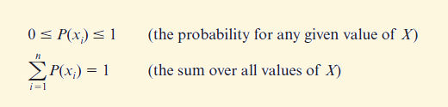
Discrete Distributions
Chapter 6
Probability Distributions
A discrete probability distribution assigns a probability to each value of a discrete random variable X.
To be a valid probability distribution, the following must be satisfied.
Notes:
Discrete Distributions:
A discrete distribution assigns a probability to each value of a discrete random variable.
A valid discrete probability distribution is such that the probability for each value lies between 0 and 1 inclusive and the sum of the probabilities will equal to 1.

Slide 41
Discrete Distributions
Chapter 6
Example: Coin Flips able 6.1)
When a coin is flipped 3 times, the sample space will be
S = {HHH, HHT, HTH, THH, HTT, THT, TTH, TTT}.
Possible Events | x | P(x)
TTT | 0 | 1/8
HTT, THT, TTH | 1 | 3/8
HHT, HTH, THH | 2 | 3/8
HHH | 3 | 1/8
Total |  | 1
If X is the number of heads, then X is a random variable whose probability distribution is as follows:
Notes:
Discrete Distributions:
The slide shows an example of a discrete probability distribution.

Slide 42
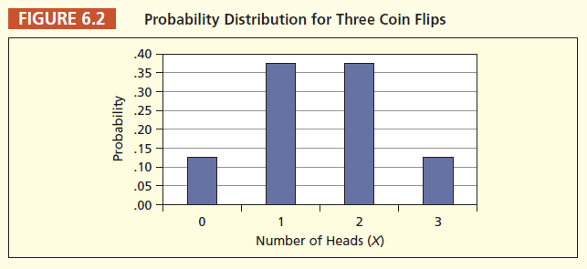
Discrete Distributions
Chapter 6
Example: Coin Flips
Note that the values of X need not be equally likely. However, they must sum to unity.
Note also that a discrete probability distribution is defined only at specific points on the X-axis.
Notes:
Discrete Distributions:
Example continued.

Slide 43

Discrete Distributions
Chapter 6
Expected Value
The expected value E(X) of a discrete random variable is the sum of all X-values weighted by their respective probabilities.
If there are n distinct values of X, then
E(X) is a measure of center.
Notes:
Discrete Distributions:
When we found the mean for a set of values, the weights were the frequency count for the individual value.
When we find the mean for a discrete random variable, the weights will be the probability associated with each value.
The mean for a discrete random variable is called the expected value for the random variable. It is the long-term average for the variable.

Slide 44

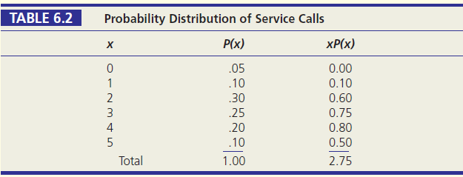
Discrete Distributions
Chapter 6
Example: Service Calls
E(X) = μ = 0(.05) + 1(.10) + 2(.30) + 3(.25) + 4(.20) + 5(.10) = 2.75
Notes:
Discrete Distributions:
The slide presents an example of how to compute the expected value for a discrete random variable.

Slide 45
Discrete Distributions
Chapter 6
Example: Service Calls
This particular probability distribution is not symmetric around the mean μ = 2.75.
However, the mean is still the balancing point, or fulcrum.
μ = 2.75
E(X) is an average and it does not have to be an observable point.
Notes:
Discrete Distributions:
Example continued.

Slide 46


Discrete Distributions
Chapter 6
Variance and Standard Deviation
If there are n distinct values of X, then the variance of a discrete random variable is:
The variance is a weighted average of the variability about the mean and is denoted either as σ² or V(X).
The standard deviation is the square root of the variance and is denoted σ.
Notes:
Discrete Distributions:
We can also compute the variance and standard deviation for a discrete random variable.
The slide shows the equations used for these computations.

Slide 47
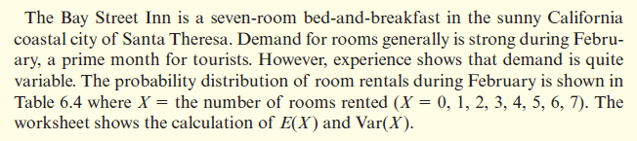
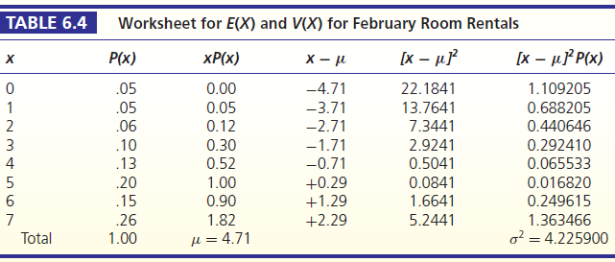
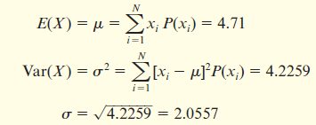
Discrete Distributions
Chapter 6
Example: Bed and Breakfast
Notes:
Discrete Distributions:
Example used to demonstrate the computations for the variance and standard deviation for a discrete random variable.

Slide 48
Discrete Distributions
Chapter 6
Example: Bed and Breakfast
The histogram shows that the distribution is skewed to the left.
The mode is 7
rooms rented but
the average is only 4.71 room rentals.
σ = 2.06 indicates considerable variation around μ.
Notes:
Discrete Distributions:
Example continued.

Slide 49
Discrete Distributions
Chapter 6
What Is a PDF or CDF?
A probability distribution function (PDF) is a mathematical function that shows the probability of each X-value.
A cumulative distribution function (CDF) is a mathematical function that shows the cumulative sum of probabilities, adding from the smallest to the largest X-value, gradually approaching unity.
Notes:
Discrete Distributions:
Sometimes we can use a function to describe the probability distribution for a discrete random variable.
These functions are used to compute the probability for the values of the random variable.
These functions are called probability distribution functions.
Also, if the probabilities are accumulated, we can use the cumulative distribution function. This function gives the probability of the variable less than or equal to some number for the random variable.

Slide 50


Discrete Distributions
Chapter 6
What Is a PDF or CDF?
Consider the following illustrative histograms:
CDF = P(X ≤ x)
PDF = P(X = x)
Illustrative PDF
(Probability Density Function)
Cumulative CDF
(Cumulative Density Function)
Notes:
Discrete Distributions:
Figure 6.5 shows the graphical representations of a PDF and CDF.

Slide 51

Uniform Distribution
Chapter 6
Characteristics of the Uniform Discrete Distribution
The uniform distribution describes a random variable with a finite number of integer values from a to b (the only two parameters).
Each value of the random variable is equally likely to occur.
For example, in lotteries we have n equiprobable outcomes.
Notes:
Uniform Distribution:
A discrete uniform distribution describes a random variable with a finite number of integer values.
Each value of the random variable is equally likely to occur.

Slide 52

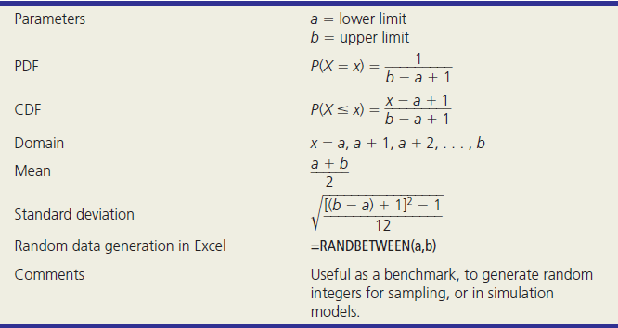
Uniform Distribution
Chapter 6
Characteristics of the Uniform Discrete Distribution
Notes:
Uniform Distribution:
Table 6.5 lists the properties of a uniform discrete distribution whose values range from a to b. These values are called the parameters for the uniform discrete probability distribution.

Slide 53

Uniform Distribution
Chapter 6
Example: Rolling a Die
The number of dots on the roll of a die forms a uniform random variable with six equally likely integer values: 1, 2, 3, 4, 5, 6
What is the probability of getting any of these on the roll of a die?
PDF for one die
CDF for one die
Notes:
Uniform Distribution:
Figure 6.6 displays the bar charts that represent the PDF and CDF for the distribution of the number on the face of a regular six-sided die when rolled once.

Slide 54



Uniform Distribution
Chapter 6
Example: Rolling a Die
The PDF for all x is:
Calculate the mean as:
Calculate the standard deviation as:
Notes:
Uniform Distribution:
Example continued. The slide shows the computations for the mean and standard deviation.
The mean of 3.5 indicates that if we roll the die a large number of times, then the average of the numbers on the upward face will be 3.5.

Slide 55
Binomial Probability Distribution ML 4.3
Chapter 5
Characteristics of the Binomial Distribution
The binomial distribution arises when a Bernoulli experiment (X = 0 or 1) is repeated n times.
example
Each trial is independent so the probability of success π remains constant on each trial.
In a binomial experiment, we are interested in X = number of successes in n trials. So,
The probability of a particular number of successes P(X) is determined by parameters n and π.
Notes:
Contents of the Chapter:
There are eight sections in this chapter. The topics in each section are listed above.

Slide 56

Bernoulli Distribution
Chapter 6
Bernoulli Experiments
A random experiment with only 2 outcomes is a Bernoulli experiment.
One outcome is arbitrarily labeled a “success” (denoted X = 1) and the other a “failure” (denoted X = 0).
e.g., coin flip
π is the P(success), 1 − π is the P(failure).
“Success” is usually defined as the less likely outcome so that π < .5, but this is not necessary.
The Bernoulli distribution is of interest mainly as a gateway to the binomial distribution (n repated Bernoulli experiments).
Notes:
Bernoulli Distribution:
A random experiment with only two possible outcomes is called a Bernoulli experiment.
We usually label the outcomes as “success” or “failure.” For example, if we toss a coin once, there are just two possible outcomes for this experiment. We may label the outcome of a head as a success and the outcome of a tail as the failure.
The slide also gives the function for this distribution along with the mean and variance for the distribution.

Slide 57
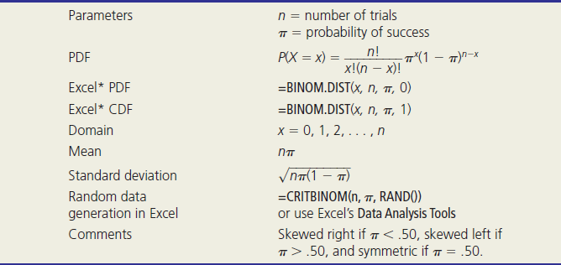
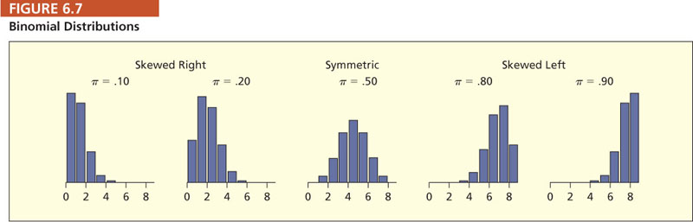
Binomial Distribution
Characteristics of the Binomial Distribution
Chapter 6
Notes:
Binomial Distribution:
Table 6.7 shows the characteristics of the binomial distribution.

Slide 58
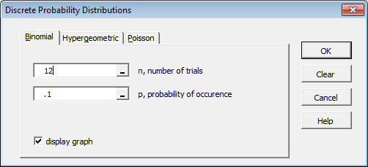
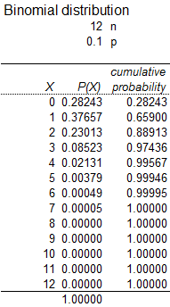
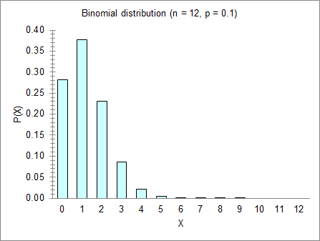
Binomial Distribution
Chapter 6
Example: MegaStat’s binomial with n = 12, p = .10
Notes:
Binomial Distribution:
Table 6.7 shows the characteristics of the binomial distribution.

Slide 59

Binomial Distribution
Example: Quick Oil Change Shop
Chapter 6
Quick Oil Change shops want to ensure that a car’s service time is not considered “late” by the customer. The recent percent of “late” cars is 10%.
Service times are defined as either late (1) or not late (0).
X = the number of cars that are late out of the number of cars serviced.
P(car is late) = π = .10
P(car is not late) = 1 − π = .90
Assumptions:
- Cars are independent of each other.
- Probability of a late car is constant.
Notes:
Binomial Distribution:
This gives an example of a binomial experiment.

Slide 60


Binomial Distribution
Example: Quick Oil Change Shop
Chapter 6
What is the probability that exactly 2 of the next n = 12 cars serviced are late (P(X = 2))? For a single X value, we use the binomial PDF:
from MegaStat
0 for PDF, 1 for CDF
The Excel PDF syntax is: =BINOM.DIST(x,n,π,0)
so we get =BINOM.DIST(2,12,0.1,0) = .2301
Notes:
Binomial Distribution:
Example continued. The slide shows the probability function for the experiment. One can use this function to compute probabilities for the experiment.

Slide 61

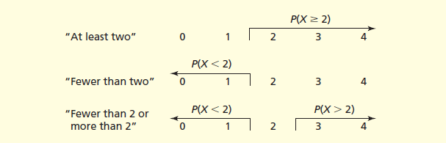
Binomial Distribution
Chapter 6
Compound Events
Individual P(X) values can be summed. It is helpful to sketch a diagram to guide you when we are using the CDF:
Notes:
Binomial Distribution:
Figure 6.9 shows some helpful sketches to help solve for the required probabilities in the example.

Slide 62
Binomial Distribution
Chapter 6
Compound Events
On average, 20% of the emergency room patients at Greenwood General Hospital lack health insurance (π = .20). In a random sample of four patients (n = 4), what is the probability that at least two will be uninsured? This is a compound event.
from MegaStat
0 1 2 3 4
compound event of interest
Individual probabilities can be added so:
P(X ≥ 2) = P(2) + P(3) + P(4)
or, alternatively,
P(X ≥ 2) = 1 – P(X ≤ 1) = 1 - .8192 = .1808
= .1536 + .0256 + .0016 = .1808
0 for PDF, 1 for CDF
The syntax of the Excel formula for the CDF is: =BINOM.DIST(x,n,π,1)
so we get =1-BINOM.DIST(1,4,0.2,1) = .1808
Notes:
Binomial Distribution:
Example continued.

Slide 63
Binomial Distribution
Chapter 6
More Compound Events
from MegaStat
Given: On average, 20% of the emergency room patients at Greenwood General Hospital lack health insurance (n = 4 patients, π = .20 no insurance).
What is the probability that fewer than 2 patients lack insurance?
HINT: What inequality means “fewer than”?
P(X < 2) = P(0) + P(1)
= .4096 + .4096 = .8192
What is the probability that no more than 2 patients lack insurance?
HINT: What inequality means “no more than”?
P(X ≤ 2) = P(0) + P(1) + P(2)
= .4096 + .4096 + .1536 = .9728
Excel’s CDF function for P(X ≤ 2) is =BINOM.DIST(2,4,0.2,1) = .9728
Notes:
Binomial Distribution:
Example continued.

Slide 64
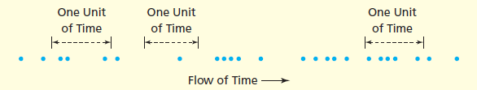
Poisson Probability Distribution ML 4.4
Chapter 6
Poisson Events Distributed over Time.
Called the model of arrivals, most Poisson applications model arrivals per unit of time.
Events are assumed to occur randomly and independently over a continuum of time or space:
Each dot (•) is an occurrence of the event of interest.
Notes:
Poisson Distribution:
Most Poisson applications deal with the number of arrivals or events during a given unit of time.

Slide 65
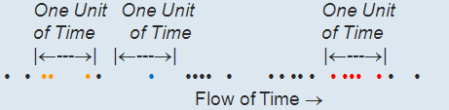
Poisson Distribution
Chapter 6
Poisson Events Distributed over Time.
Let X = the number of events per unit of time.
X is a random variable that depends on when the unit of time is observed.
Example: we could get X = 3 or X = 1 or X = 5 events, depending on where the randomly chosen unit of time happens to fall.
The Poisson model’s only parameter is λ (Greek letter “lambda”), where λ is the mean number of events per unit of time or space.
Notes:
Poisson Distribution:
The mean number of arrivals or events per unit of time (or space) is denoted by the Greek letter λ (lambda).

Slide 66
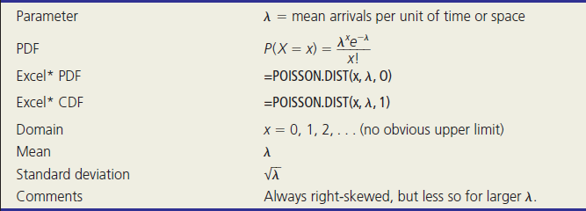
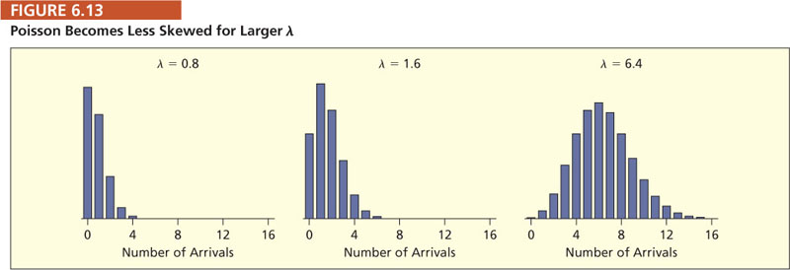
Poisson Distribution
Characteristics of the Poisson Distribution
Chapter 6
Notes:
Poisson Distribution:
Table 6.9 lists the characteristics for the Poisson distribution and some useful Excel functions to help with computations for the distribution.

Slide 67
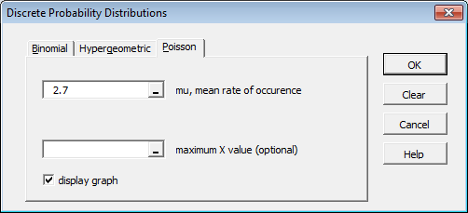
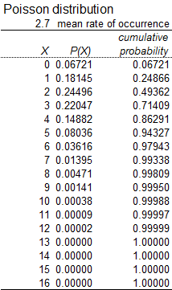
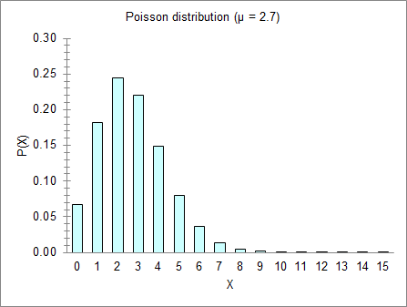
Poisson Distribution
Chapter 6
Example: MegaStat’s Poisson with λ = 2.7
Notes:
Binomial Distribution:
Table 6.7 shows the characteristics of the binomial distribution.

Slide 68
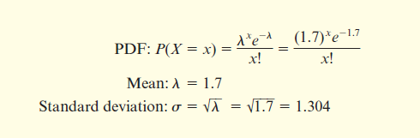
Poisson Distribution
Chapter 6
Example: Credit Union Customers
On Thursday morning between 9 a.m. and 10 a.m. customers arrive and enter the queue at the Oxnard University Credit Union at a mean rate of 1.7 customers per minute.
Find the PDF, mean, and standard deviation for X = customers per minute.
Notes:
Poisson Distribution:
This slide presents an example that deals with the Poisson distribution.

Slide 69
Poisson Distribution
Appendix B
Chapter 6
On Thursday morning between 9 a.m. and 10 a.m. customers arrive and enter the queue at the Oxnard University Credit Union at a mean rate of 1.7 customers per minute. What is the probability that two or fewer customers will arrive in a given minute?
Answer:
P(X ≤ 2) = P(0) + P(1) + P(2)
= .1827 + .3106 + .2640 = .7573
Notes:
Poisson Distribution:
Example continued.

Slide 70
Poisson Distribution
Excel Function
Chapter 6
On Thursday morning between 9 a.m. and 10 a.m. customers arrive and enter the queue at the Oxnard University Credit Union at a mean rate of 1.7 customers per minute. What is the probability that two or fewer customers will arrive in a given minute?
Answer: P(X ≤ 2) = P(0) + P(1) + P(2)
= .1827 + .3106 + .2640 = .7573
Using Excel, we can do this in one step.
This is a left-tailed area, so we want the CDF for P(X ≤ 2).
The Excel formula CDF syntax is =POISSON.DIST(x,λ,1)
The result is =POISSON.DIST(2,1.7,1) = .7572
,
0 for PDF, 1 for CDF
Notes:
Poisson Distribution:
Example continued.

Slide 71

Poisson Distribution
MegaStat
Chapter 6
On Thursday morning between 9 a.m. and 10 a.m. customers arrive and enter the queue at the Oxnard University Credit Union at a mean rate of 1.7 customers per minute. What is the probability that two or fewer customers will arrive in a given minute?
Answer: P(X ≤ 2) = P(0) + P(1) + P(2)
= .1827 + .3106 + .2640 = .7573
it’s easy using MegaStat
Notes:
Poisson Distribution:
Example continued.

Slide 72
Poisson Distribution
Compound Events
Chapter 6
On Thursday morning between 9 a.m. and 10 a.m. customers arrive and enter the queue at the Oxnard University Credit Union at a mean rate of 1.7 customers per minute. What is the probability of at least three customers?
Answer:
P(X ≥ 3) = 1 − P(X ≤ 2)
= 1 − .7573 =.2427
it’s easy using MegaStat
Notes:
Poisson Distribution:
Example continued.

Slide 73
Poisson Distribution
Chapter 6
Apprioximation to Binomial
The Poisson distribution may be used to approximate a binomial by setting λ = nπ.
This approximation is helpful when the binomial calculation is difficult (e.g., when n is large).
The general rule for a good approximation is that n should be “large” and π should be “small.”
A common rule of thumb says the Poisson-Binomial approximation is adequate if n ≥ 20 and π ≤ .05.
This approximation is rarely taught nowadays because Excel can calculate binomials even for very large n or small π.
Notes:
Poisson Distribution:
We can use the Poisson distribution to approximate the binomial distribution by letting λ = nπ.
The general rule for the approximation is that “n” should be large and “π” should be small.
Also, one can use the common rule of thumb of n ≥ 20 and π ≤ 0.05.

Slide 74
Other Discrete Distributions ML 4.5
Chapter 6
The distributions illustrated below are useful, but less common.
Their probabilities are easily calculated in Excel
Hypergeometric Distribution
(sampling without replacement)
Geometric Distribution
(trials until first success)
Notes:
Learning Objectives:
Listed are the first five learning objectives for this chapter. These objectives will be discussed as the chapter progresses.

Slide 75
Hypergeometric Distribution
Chapter 6
Characteristics of the Hypergeometric Distribution
The hypergeometric distribution is similar to the binomial distribution.
However, unlike the binomial, sampling is without replacement from a finite population of N items.
The hypergeometric distribution may be skewed right or left and is symmetric only if the proportion of successes in the population is 50%.
Probabilities are not easy to calculate by hand, but Excel’s formula =HYPGEOM.DIST(x,n,s,N,TRUE) makes it easy.
Notes:
Hypergeometric Distribution:
This distribution is similar to the binomial distribution.
However, sampling is done without replacement from a finite population of size N.
The distribution could be left or right skewed. It will be symmetric only if the proportion of successes in the population is 0.5.

Slide 76
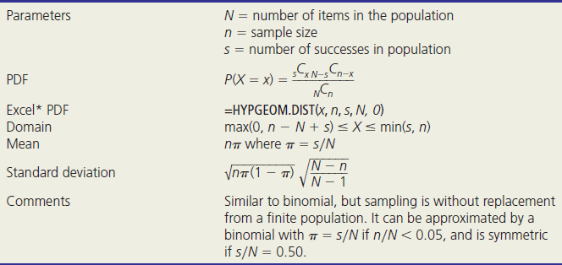
Hypergeometric Distribution
Chapter 6
Characteristics of the Hypergeometric Distribution
Notes:
Hypergeometric Distribution:
The slide lists the characteristics for the hypergeometric distribution and a useful Excel function to help with computations for the distribution.

